Slide 1
Graded Assignment 2
research done by
Ansat, Alex, Marceli, Tim

Slide 2
Hypothesis:
During the cold months we have higher concentration of pollutants, than during the summer.

Slide 3
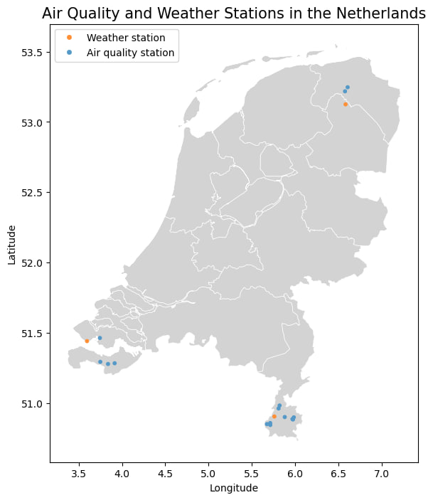
Data used and data cleaning
Cleaning rows and columns from:
Invalid data
Missing data
Irrelevant data
Cleaning data from duplicates
Merging tables together
Looking for outliers
Grouping data from different parts of regions according to:
Mean
Median

Slide 4
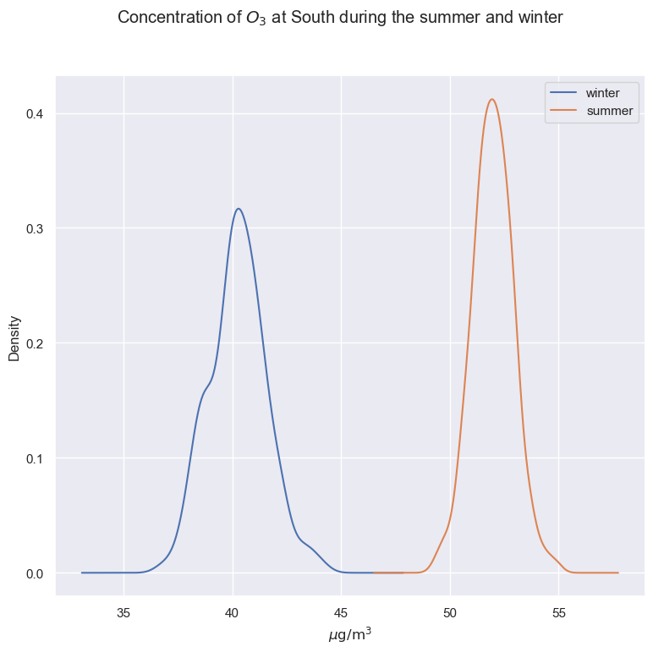
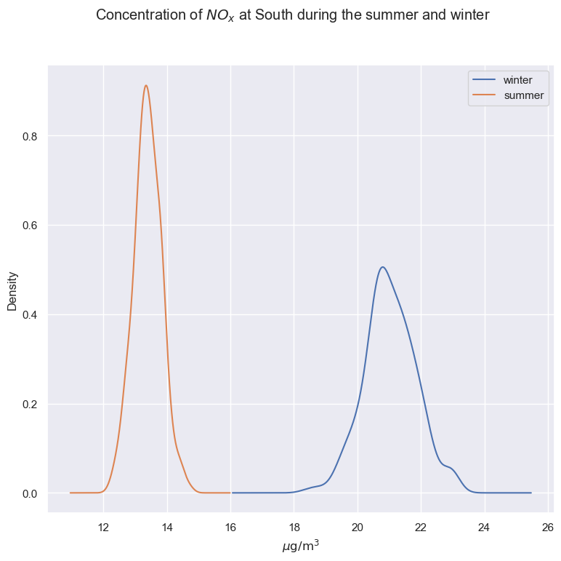
Data Normalization

Slide 5
Results
H0: mean concentration of NOx and O3 during the summer is higher than during the winter
Ha: mean concentration of NOx and O3 during the summer is lower than during the winter
Obtained p-values for NOx reject H0
Obtained p-values for O3 accept H0

Slide 6
Thank you for attention!

